Slide 1
NYPD Shooting Incident Data
Analyzing shootings in NYC between 2006-2023

Slide 2

Which Borough in NYC has the most shootings?
How old are the victims?
When do shootings occur?
Do all shooting lead to murder?

Slide 3
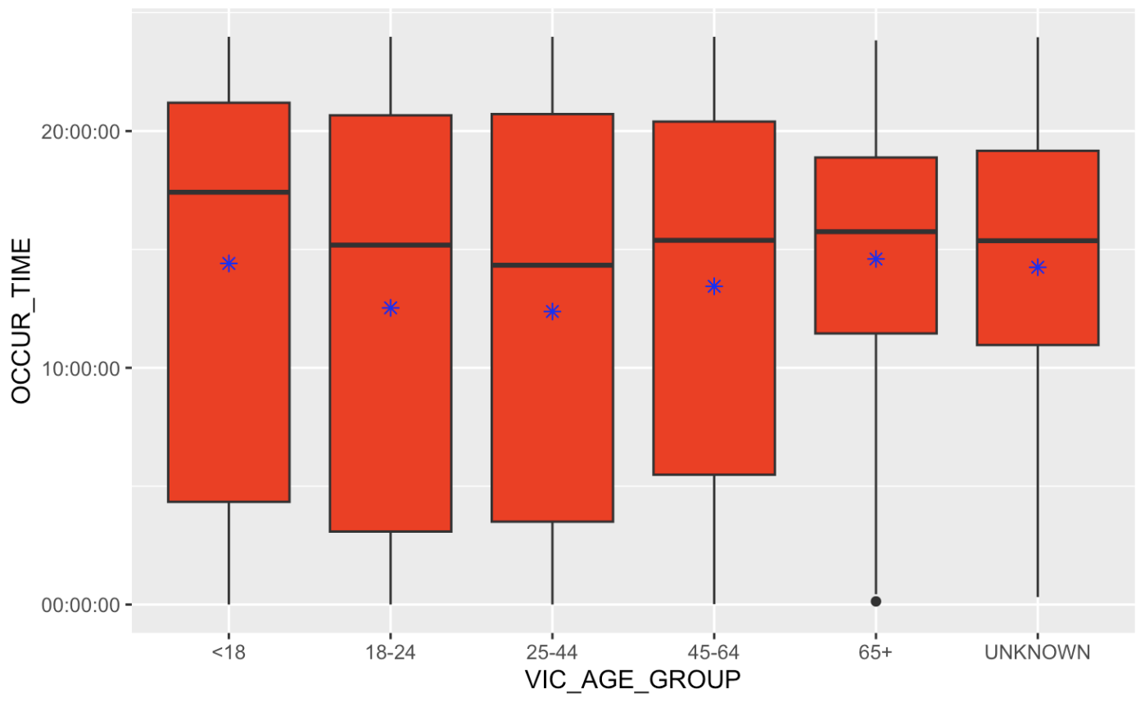
Shootings on average take place in the afternoon for all age groups
Victim Age vs Shooting Time

Slide 4
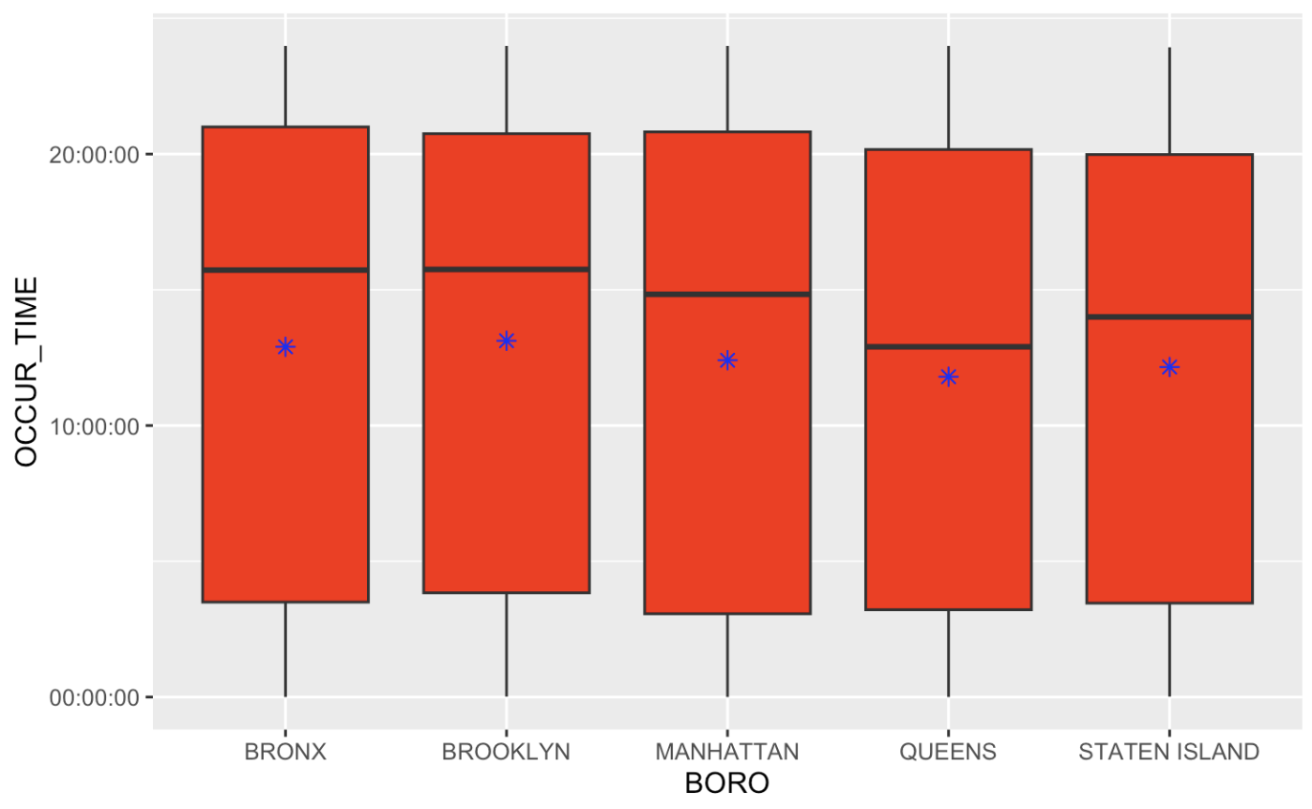
Shootings on average occurred in the afternoon in each Borough
Borough vs Shooting Time

Slide 5
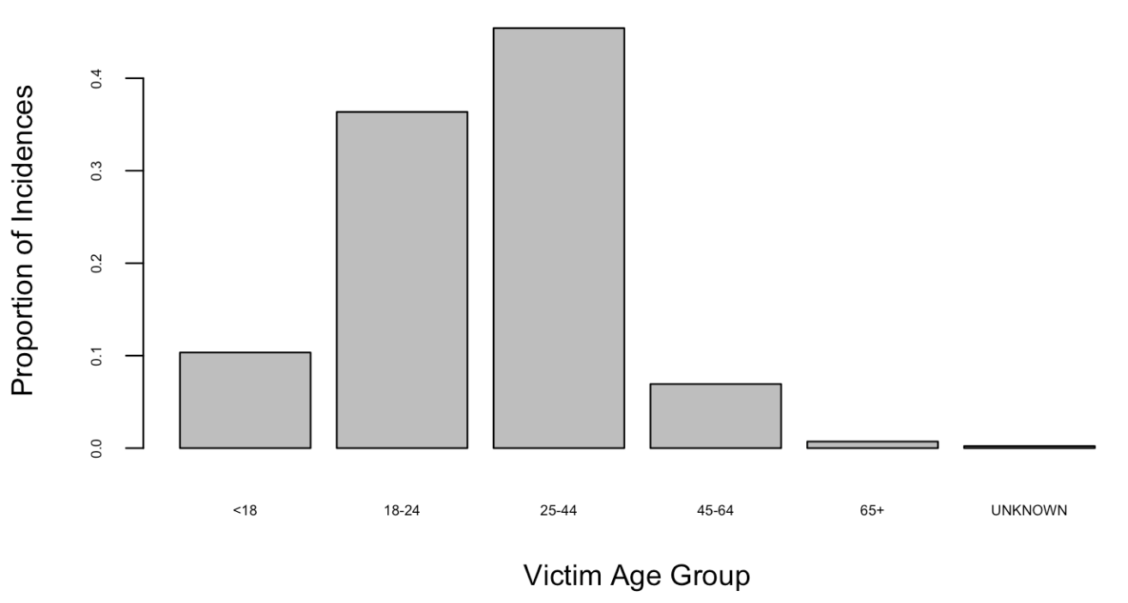
18-24 and 25-44 years olds were victims of most shootings
Victim Age vs Number of Shootings

Slide 6
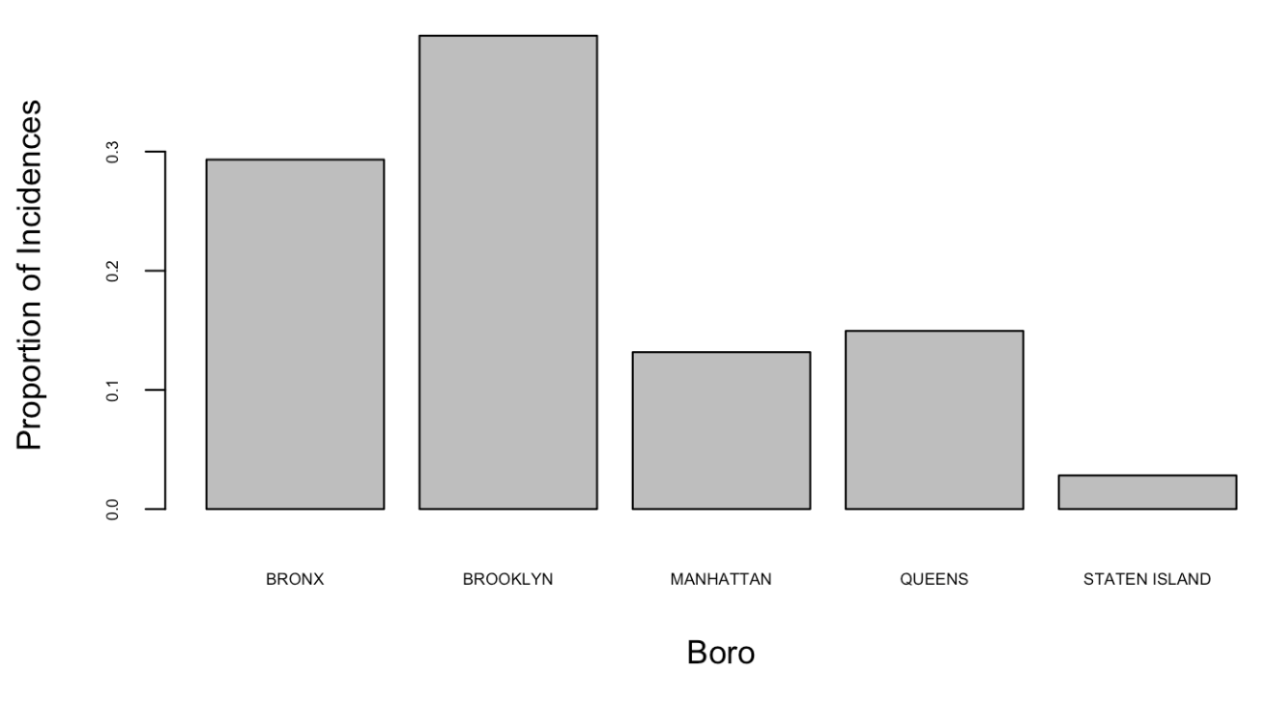
Most shootings occurred in the Bronx and Brooklyn
Borough vs Number of Shootings

Slide 7
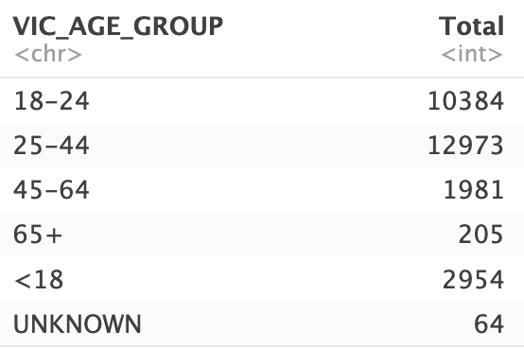
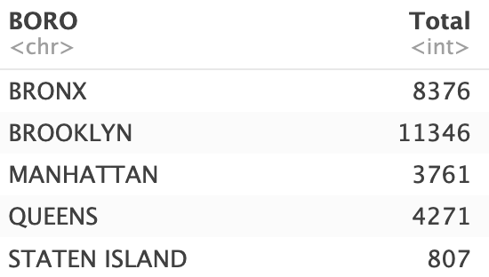
A total of roughly 28,500 shootings between 2006 and 2023. Victims aged 25-44 experienced the most shootings and Brooklyn had the highest number of shootings.

Slide 8
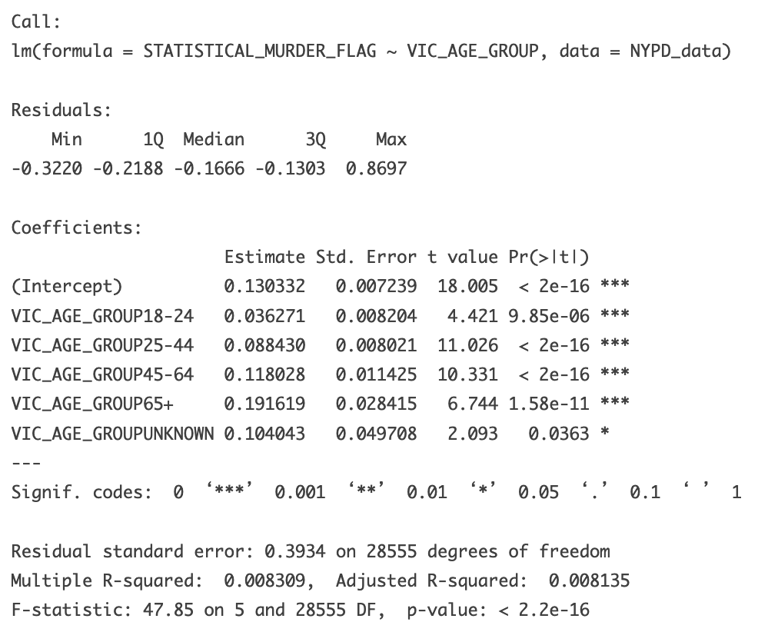
Linear Model between Victim Age Group and Statistical Murder Flag
Statistically significant relationship/correlation between victim age group and statistical murder flag (shooting results in a death/murder)
Assuming an alpha of .05, given the F-stat (47.85) and p-value (2.2e-16)

Slide 9

Bias

Slide 10
Conclusion
On average shootings occur in the afternoon across all victim age groups and boroughs
Roughly 28,500 recorded shootings between 2006 and 2023 in New York
Brooklyn (11346) and the Bronx (8376) had the most shootings
25-44 years old (12973) and 18-24 year olds (10384) most likely to be a shooting victim
Potential bias in policing and how crime data is obtained/recorded
Potential personal bias in assuming older people less likely to be involved in violent crime

